Slide 1
Prevailing Wage, Redevelopment Contract Provision and Human Trafficking Prevention Work session February 11, 2020

Slide 2
Items for discussion
Prevailing wage
Redevelopment Contract Provision
Human trafficking prevention

Slide 3
Prevailing Wage
The Davis-Bacon and Related Acts, apply to contractors and subcontractors performing on federally funded or assisted contracts in excess of $2,000 for the construction, alteration, or repair (including painting and decorating) of public buildings or public works.
Minnesota's prevailing-wage law (Minnesota Statutes 177.41 through 177.44) requires employees working on state-funded construction projects or other projects covered by law be paid wage-rates comparable to wages paid for similar work in the area where the project is located. In Hennepin county it is $57.90.

Slide 4
Background on prevailing wage
In 2016 Public Works Director Asher researched prevailing some of her finding are as follows:
Summary of responses from cities/counties requiring prevailing wage
Difficult to determine an increase to project costs since projects typically are not bid twice and with different specifications.
Anecdotally, no increase for roadway projects as most contractors are union and some increase for building projects (5-10%).
Roseville’s respondent stated they bid the same project in 2015 and 2016, with and without prevailing wage requirements, respectively, and found no noticeable difference in costs.
It can be difficult to monitor if you are completing interviews with contractors and have limited staff available. Others place compliance responsibility on the contractor.
Hastings’ respondent stated he has requested the policy be reconsidered or the contract minimum be raised to $250,000 to reduce the number of projects. The request was based on the amount of paperwork and tracking burdening staff.

Slide 5
Key points of current research
“Studies have found that prevailing wage laws result in a modest improvement in the wages of construction workers throughout the industry and a more significant increase in their fringe benefits. But research fails to provide a clear answer on the public construction costs.” –Office of the Legislative Auditor
“Four recent studies evaluating more than 2,000 bids find that prevailing wage does not reduce bid competition” – Examination of Minnesota’s Prevailing Wage Laws
“Conducted by the Kentucky Legislative Research Commission, 72 percent of the city officials, 71 percent of the county officials, 45 percent of the school officials, and 60 percent of the municipal utility officials agreed with the statement “prevailing wages decrease[the] number of bidders”on a public project” The Effect of Prevailing Wage Regulations on Contractor Bid Participation and Behavior: A Comparison of Palo Alto, California with Four Nearby Prevailing Wage Municipalities
“140 projects, 18 of which were not made under prevailing wage regulations, while the remaining 122 were, we found no evidence to support the proposition that the absence of prevailing wage regulations attracted more bidders per project or more nonunion bidders per project “The Effect of Prevailing Wage Regulations on Contractor Bid Participation and Behavior: A Comparison of Palo Alto, California with Four Nearby Prevailing Wage Municipalities
“72% of all peer-reviewed studies conducted since 2000 find that prevailing wage laws have no effect on the cost of public construction projects.” -Examination of Minnesota’s Prevailing Wage Laws
“The difficulty of separating the effect of prevailing wage laws from the effects of other policies related to construction costs contributes to the wide range of cost estimates reported in the literature.” -The Effect of Federal Davis-Bacon and
Disadvantaged Business Enterprise Regulations on Highway Maintenance Costs
“Specifically, projects covered by the introductory stage of the wage requirements are significantly less cost efficient compared to other public school projects. However, by the time of the expansion of the wage policy 17 months later, covered projects were no more cost inefficient than other projects.” -Using stochastic frontier regression to estimate the construction cost inefficiency of prevailing wage laws
“To get a true picture of the impact of prevailing wage legislation’s impact on total construction costs, one could evaluate not only differences in wage rates, but also productivity differences, the incidence of substitution, administrative costs and other ways in which these laws’ impact is either mitigated or enhanced. An alternative approach is to simply examine total construction costs directly and compare costs in the presence and absence of prevailing wage laws controlling for project differences” –Impact of Prevailing Wage on Construction Costs
“Federal construction projects governed by Davis Bacon were 23 percent more expensive than private construction projects controlling for other cost influencing factors. When they re-estimate their basic model to correct for disproportionate response rates by region and building type, Fraundorf finds that the impact of Davis Bacon on total construction costs is as high as 30 percent” –The Effects of Prevailing Wage in Rural Projects
Notes:
The research varies tremendously depending on proponents and vice versa and focuses on:
1. Impact of prevailing wage law on public construction costs,
2. Training and the maintenance of a skilled workforce,
3. Workplace safety
4. Supporting of local economies
It is important to note that most studies focus on the federal/state enforcement of prevailing wage and to understand the studies and what type of data they use and sue they are controlling for similar costs to make feasible comparisons.
“ Controlling for employment, year and state, he finds that in absence of prevailing wage laws on the job injuries by all measures increase” The Economics of prevailing wage law

Slide 6
Prevailing wage ordinances
Coon Rapids: https://library.municode.com/mn/coon_rapids/codes/code_of_ordinances?nodeId=TIT12BU_CH12-600PRWARE. Applies to city contracts over $100,000; uses the same rate as the State as determined by Dept. of Labor and Industry.
Duluth: https://library.municode.com/mn/duluth/codes/legislative_code?nodeId=Chapter%202%20-%20Administration (starting on page 11). Applies to city projects over $2,000 or more; uses the State rate.
Grand Rapids: https://library.municode.com/mn/grand_rapids/codes/code_of_ordinances?nodeId=COOR_CH2AD_ARTIVFI_DIV2PRWARAHOLAEMCO_S2-111DE (Sections 2-111 through 2-116) – applies to contracts over $25,000 or $50,000 depending on the trades/occupations involved; uses the State rate.
Maplewood: https://library.municode.com/mn/maplewood/codes/code_of_ordinances?nodeId=COOR_CH2AD_ARTIINGE_S2-8CIPRPRWARA – applies to projects that must be competitively bid using 100% city funds; uses the State rate.
West St. Paul: https://codelibrary.amlegal.com/codes/weststpaul/latest/weststpaul_mn/0-0-0-574#rid-0-0-0-608 – applies to projects $50,000 or more that receive specific financial assistance from city; doesn’t seem to specify what prevailing wage is.
White Bear Lake: https://www.whitebearlake.org/sites/default/files/fileattachments/administration/page/1701/chapter_506.pdf - applies to city projects over $15,000 and uses State rate.
Minneapolis: https://www.municode.com/library/mn/minneapolis/codes/code_of_ordinances?nodeId=COOR_TIT2AD_CH24PUWO_ARTIVCO_24.220PRWARE-&searchText=
St. Paul: https://www.municode.com/library/mn/st._paul/codes/code_of_ordinances?nodeId=PTIIIADCO_TITIVPOPR_CH82PUPRPUCO_S82.07MIWAPUCO - applies to HRA projects $25,000 or more or where the city or HRA provides financial assistance; uses State rate.

Slide 7
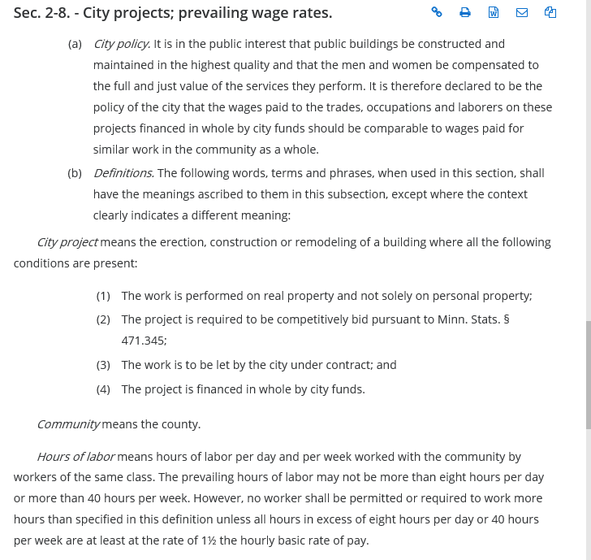
Maplewood Prevailing wage
Example:

Slide 8
Compliance concerns
Contractors or subcontractors can evade prevailing wage requirements by:
-understating the hours worked by employee
-contractor refusing to pay fringe benefits such as pension
-misclassification of employees
-failure to pay correct overtime work

Slide 9
Enforcement/monitoring practices
City of Richfield could mirror the current enforcement practices by general contractors in public projects by requiring:
1) Certified Payroll Records
Require contractors and sub contractors to submit weekly or biweekly certified payroll records. Certified payroll records include but are not limited to, hours worked each day by each construction worker, job classification and rate of pay.
2) Onsite interviews
Conduct randomized interviews which ask workers about their work, their compensation rate, hours of work. These interviews are usually done two times during the life of the project and there can be a requirement for language access for workers that do not have English proficiency.
3)Inspector check-in
Ensure that onsite inspector keeps a daily journal of construction activity that may include onsite interviews and the review of certified payroll records.

Slide 10
General contractor input
-Does not impact the contractors bid, it simply may impact the total construction costs due to increased enforcement and monitoring.
-Improves the quality of life for the local construction workers.
-Some subcontractors already include prevailing wage without it being a requirement.
-Not much experience with City Prevailing Wage specifications.
-Costs to a project vary but average additional fees per week between $500-$750/week during the construction season, to enforce prevailing wage. Covers the certified payroll and onsite constructions, other enforcement costs.

Slide 11
Recommendation
​Costs to the city are medium-high due to the need for oversight, implementation, and ongoing enforcement. The research was inconsistent making it difficult to predict the increase cost if any, in future contracts and administrative costs of enforcement.
​Limitations include increased costs and lack of staff expertise to enforce the prevailing wage requirements. Based on initial research, Director Asher recommended including a prevailing wage requirement for any project over $300,000. Though the starting point of $300,000 seems reasonable to expand a prevailing wage requirement should consider costs of implementation and ongoing enforcement.

Slide 12
Redevelopment Contract Provision
Redevelopment Contract Agreements can be written to include:
- a developer commitment to comply with all federal, state and local labor laws;
- a requirement that the developer provide documentation of proper payment to all contractors, subcontractors and project laborers prior to the issuance of a Certificate of Compliance, and;
- an acknowledgement that failure to comply with the above points would result in a default of the development agreement and could result in a penalty (such as non-issuance of TIF Note, or, if the TIF Note has already been issued, delaying, reducing and/or ceasing TIF Note payments.
-language would only be valid until a Certificate of Completion were issued once all contractual obligations have been met (usually within 18 months of conclusion of construction).

Slide 13
Costs to the City are medium to high as the HRA could incur legal costs in concluding developer is in default of contract and/or in withholding funds;
Limitations include:
- developer may be unaware of all subcontractors and suppliers;
- staff does not have the capacity to conduct site visits to determine if there are workers who are excluded from the list;
-may set an unrealistic expectation that staff is monitoring and blame assigned to staff if not followed.

Slide 14
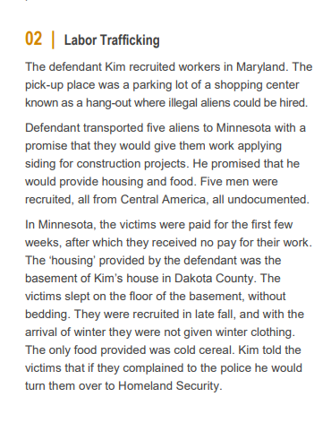
Prevention of labor trafficking
Cities around the country are enforcing human trafficking public awareness signs in establishments, city projects and other venues of interest. The signs alert employees and patrons to remedies and protections related to human trafficking.

Slide 15
Costs for the implementation of labor trafficking prevention signs to the city are low.
Limitations lie on the lack of resources to investigate human trafficking cases.

Slide 17
Summary of recommendations
1. Staff recommends including a prevailing wage requirement for any project over $300,000.
2.Staff recommends redevelopment contractual agreement provisions.
3. Staff recommends the use of labor trafficking prevention signs in construction sites and other spaces where labor trafficking may occur.
Staff seeks council approval to implement the first and third recommendation.
Staff seeks council direction to further research the feasibility of the redevelopment contractual agreement provisions.
Next steps

